Slide 1
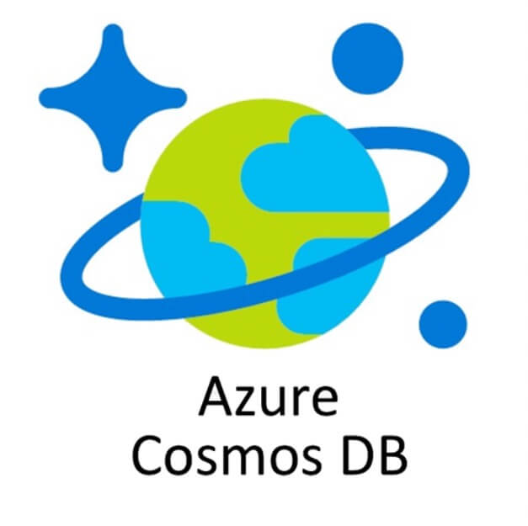


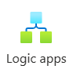
Apache Spark Streaming – Inventory Details Using Cosmos DB and Loading into Delta Lake

Slide 2
Table of Contents
Use case details – Goal
Architecture Diagram – Technical Details
Difference between batch processing & Spark Streaming
Cosmos DB – NO SQL – concepts of Containers & Items
Spark Streaming write modes
For each function, Window functions
Spark watermark
Stream joins – Static-Stream joins & Stream-Stream join

Slide 3


Architecture Diagram
Inventory Data
PO/Requisition Details

Slide 4
Apache Spark Streaming Use Case
Orders are placed from different stores for chain store, Order details are loaded into a Cosmos DB.
There is a stock/inventory supply details in the Cosmos DB in a different table.
Primary use case is an alarm/email trigger when an alert is needed when the orders placed for a given Item vs stock/inventory details have fallen down the below threshold & need an emergency refill.
Tech components that would be used are as below:
Apache Spark Structured Streaming – Python Spark – Azure Databricks.
Source for stream is Cosmos DB table.
Data is written into a BLOB Delta table/Delta Hive Metastore of Databricks.

Slide 5
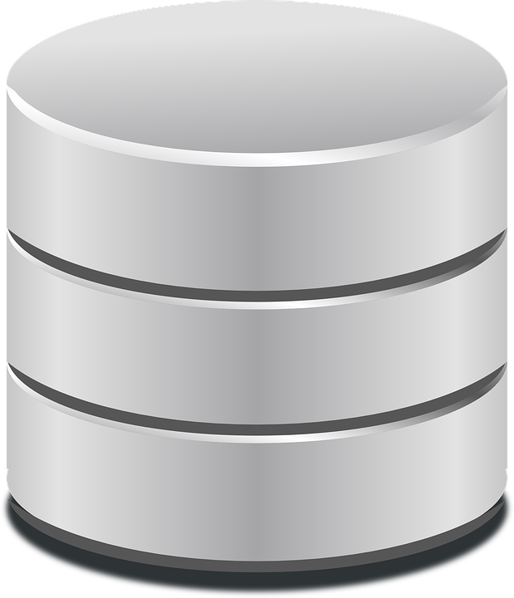

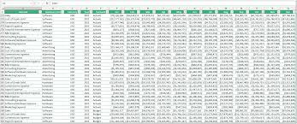

Spark Streaming Vs Spark Batch Processing
 | Spark Batch Processing | Spark Streaming
 | Most storage and processing resources requirement to process large batches of data. | Less storage required to process current data packets.
 | Latency could be minutes, hours, or days | Latency must be guaranteed in milliseconds
 | Large batches of data | Continuous streams of data
 | Complex computation and analysis of a larger time frame | Simple reporting or computation

Slide 6
Spark Streaming Concepts:
Rate Per Micro-Batch source (for testing) :
Generates data at the specified number of rows per micro-batch, each output row contains a timestamp and value. Where timestamp is a Timestamp type containing the time of message dispatch, and value is of Long type containing the message count, starting from 0 as the first row. Unlike rate data source, this data source provides a consistent set of input rows per micro-batch regardless of query execution (configuration of trigger, query being lagging, etc.), say, batch 0 will produce 0~999 and batch 1 will produce 1000~1999, and so on. Same applies to the generated time. This source is intended for testing and benchmarking.
Window Operations:
Spark supports three types of time windows:
Tumbling Window
Session Window
Sliding Window

Slide 7
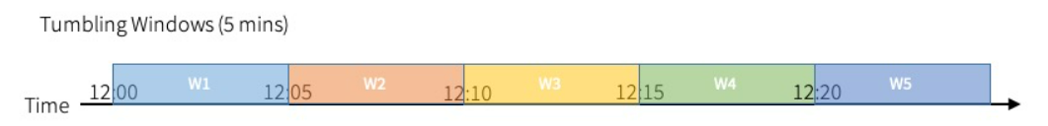
Tumbling windows are a series of fixed-sized, non-overlapping and contiguous time intervals. An input can only be bound to a single window.
sessionizedCounts = events \
.withWatermark("timestamp", "10 minutes") \
.groupBy(
session_window(events.timestamp, "5 minutes"),
events.userId) \
.count()
Current to our project we would consider the total quantity of the items placed with in the window. We would have a typical running sum on the total quantities of the orders placed.

Slide 8
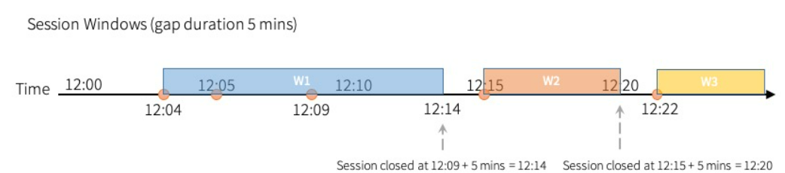
Session windows have different characteristic compared to the previous two types. Session window has a dynamic size of the window length, depending on the inputs. A session window starts with an input, and expands itself if following input has been received within gap duration. For static gap duration, a session window closes when there’s no input received within gap duration after receiving the latest input.
In our current project we intend to get the sum of the item quantities in sessions, so the total item quantities placed during a given window.

Slide 9
Session windows have different characteristic compared to the previous two types. Session window has a dynamic size of the window length, depending on the inputs. A session window starts with an input, and expands itself if following input has been received within gap duration. For static gap duration, a session window closes when there’s no input received within gap duration after receiving the latest input.
In our current project we intend to get the sum of the item quantities in sessions, so the total item quantities placed during a given window.

Slide 10
Joins in Structured Streaming
There are two different joins in structured streaming
Stream-Stream Joins
Stream-Static Joins
Stream-Stream joins:
The challenge of generating join results between two data streams is that, at any point of time, the view of the dataset is incomplete for both sides of the join making it much harder to find matches between inputs. Any row received from one input stream can match with any future, yet-to-be-received row from the other input stream. Hence, for both the input streams, we buffer past input as streaming state, so that we can match every future input with past input and accordingly generate joined results. Furthermore, similar to streaming aggregations, we automatically handle late, out-of-order data and can limit the state using watermarks. Let’s discuss the different types of supported stream-stream joins and how to use them.

Slide 11
Stream –Static join:
It is a stateless transaction where join between dstream and static dataframe.

